Slide 1

mental-health trends among employees
Analysis
By:Karim deheya

Slide 2

Agenda
1-Customer Demographics
2-Workplace & Behavioral Patterns
3- Mental-Health Outcomes & Treatment Patterns
4- Geographical Insights

Slide 3
Overview
This presentation provides a comprehensive analysis of mental-health trends among employees across different demographics, workplace environments, and geographical regions. Using survey-based data, it explores how factors such as gender, age, company size, industry type, and access to mental-health benefits influence both mental-health outcomes and treatment-seeking behavior.

Slide 4

Customer Demographics

Slide 5
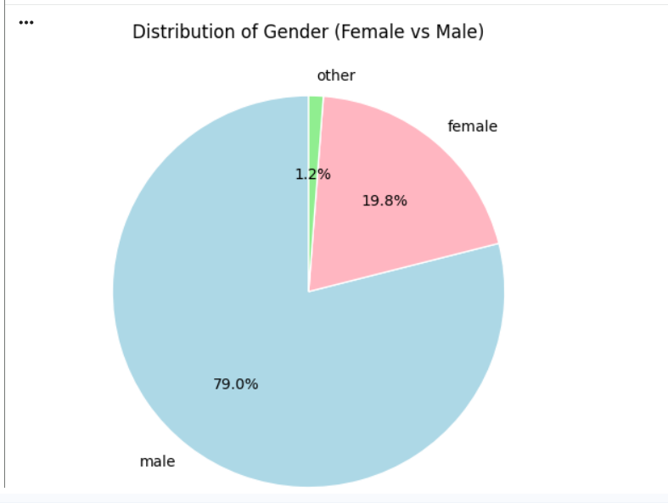
What is the overall gender distribution of survey respondents?
Most respondents are male, confirming the gender imbalance in the technology industry.

Slide 6
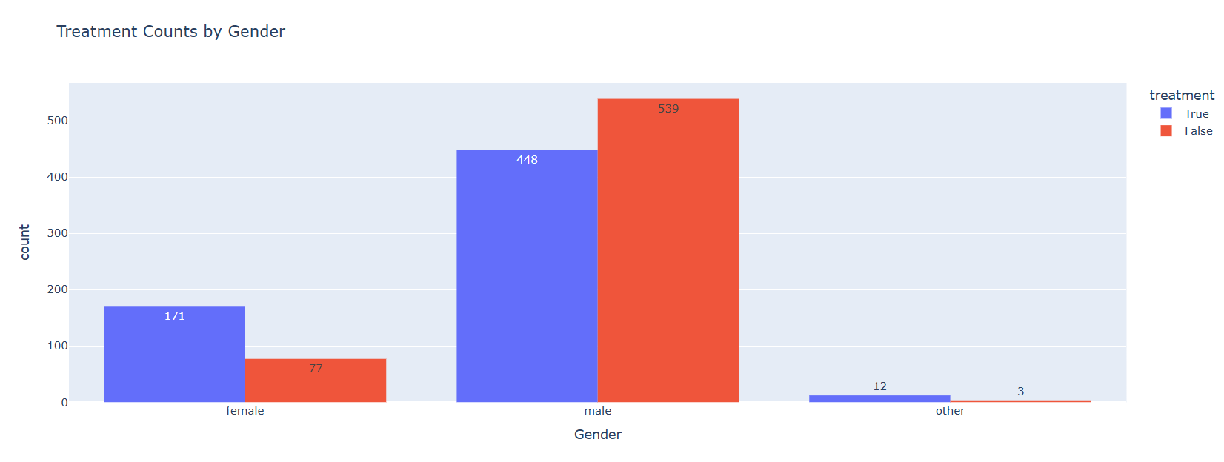
What is the Treatment Counts by Gender
Women are more proactive in seeking help, while men may under-report or avoid treatment.

Slide 7
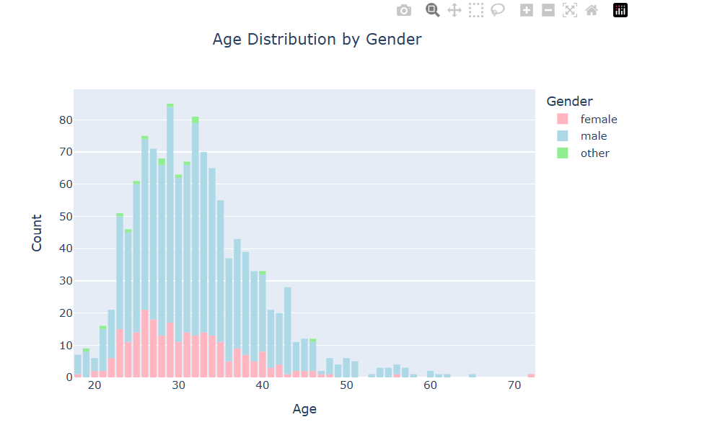
What is the overall age distribution for each gender group?
Most respondents are in their 20s and 30s, and male participants dominate all age groups.

Slide 8
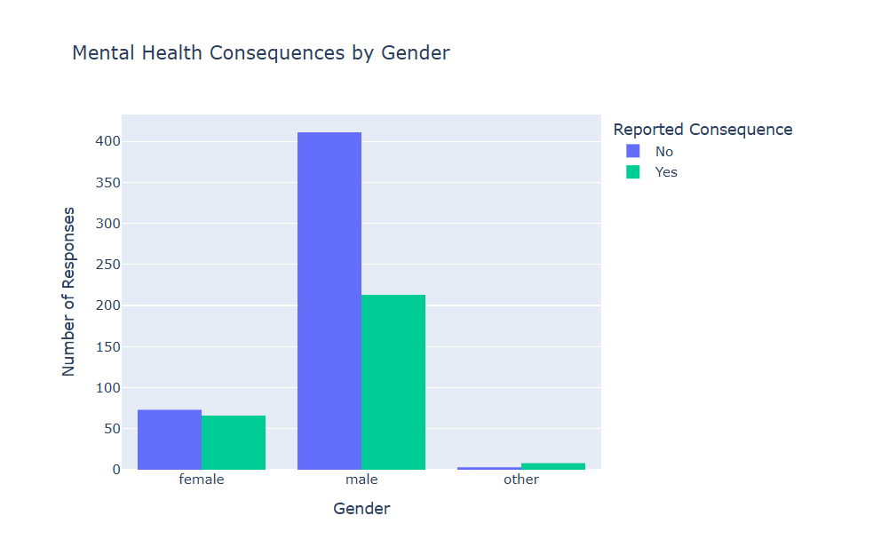
How do reported mental-health consequences differ between male, female, and other respondents?
Female and “other” gender respondents report mental-health consequences slightly more often than males.

Slide 9
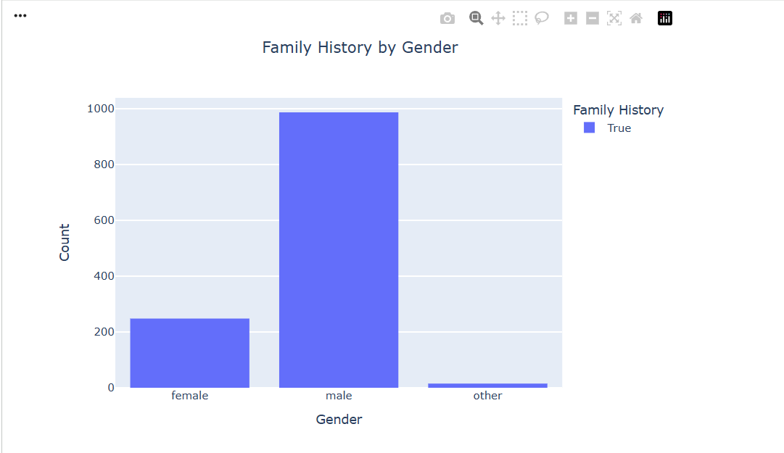
Within each gender group, what proportion of respondents report a family history of mental illness?
Males show the highest count of reported family history of mental illness.
However, this is primarily driven by their larger representation in the dataset, not necessarily a higher proportion.
Females show lower counts, consistent with their smaller sample size.

Slide 10

Workplace & Behavioral Patterns

Slide 11
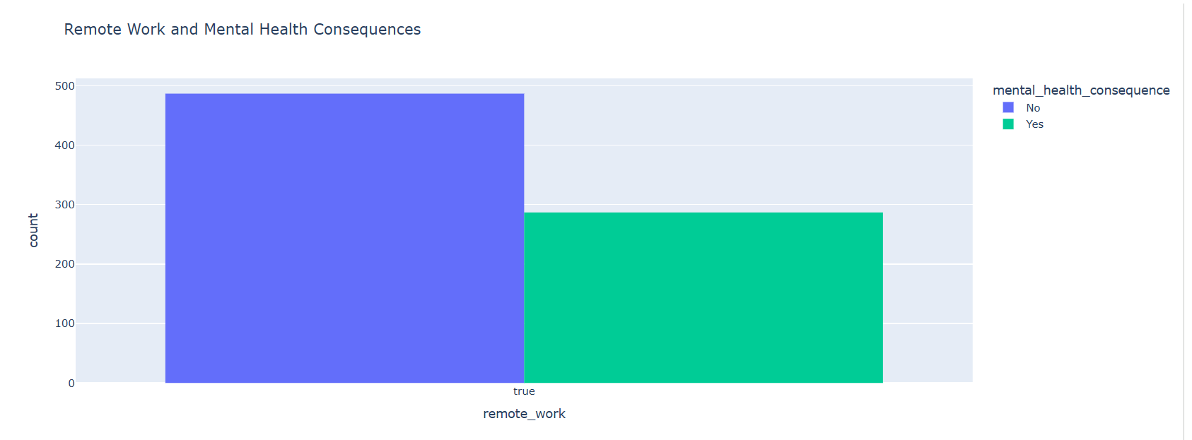
Are remote workers more or less likely to report mental-health consequences ?
Approximately 38.5% of remote workers report mental-health consequences.

Slide 12
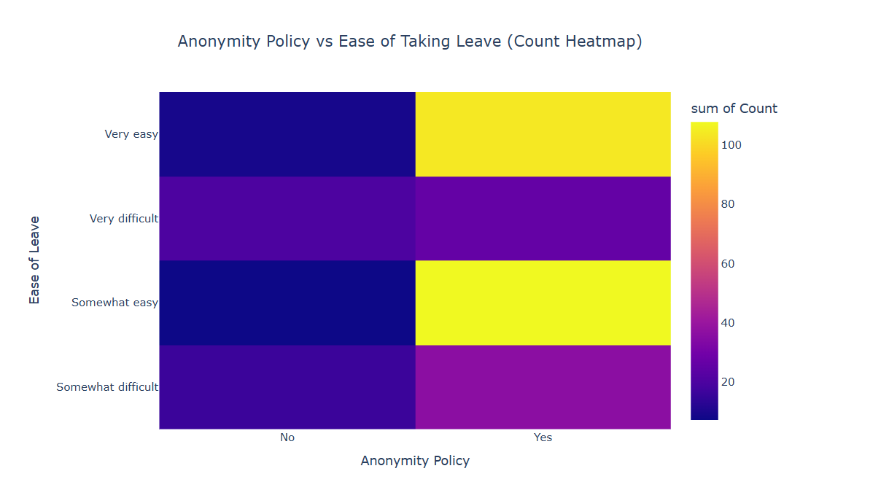
Does having an anonymity policy make employees feel more comfortable taking mental-health leave?
Companies with an anonymity policy report greater ease in taking mental-health leave.

Slide 13
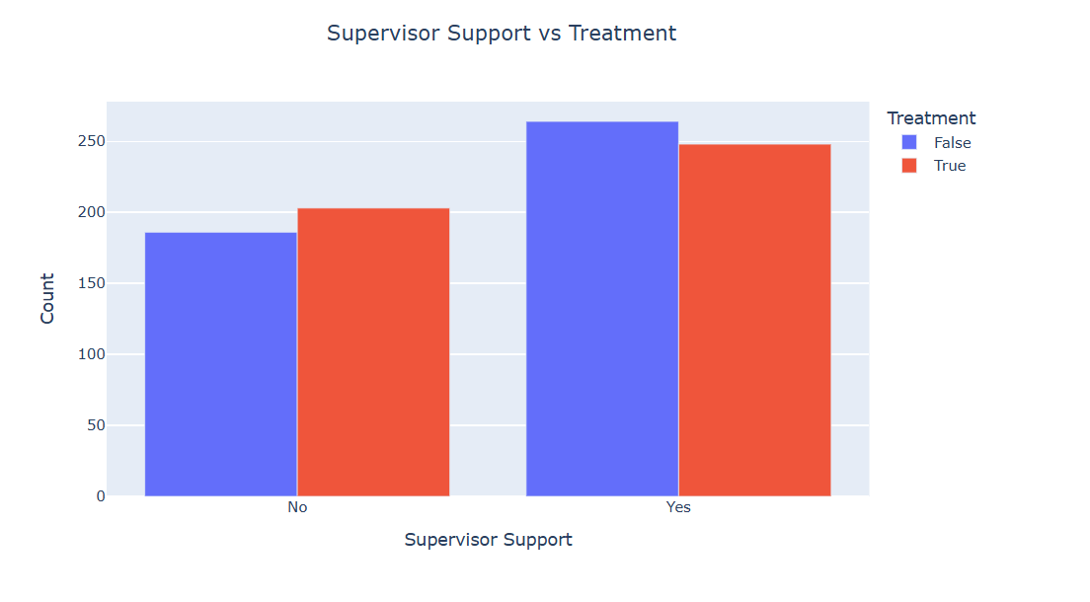
Does feeling supported by a supervisor influence whether respondents seek mental-health treatment?
Employees who report low supervisor support show significantly higher treatment-seeking behavior compared to those who feel supported.

Slide 14
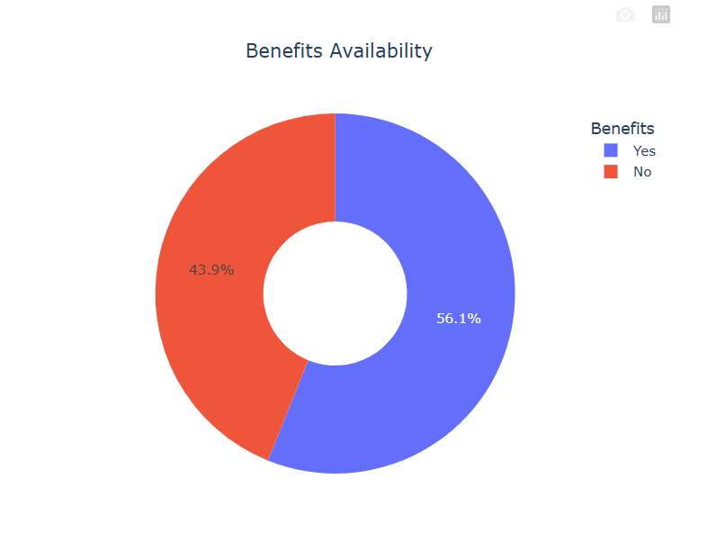
What percentage of respondents have access to mental-health benefits at their workplace?
Most respondents have access to mental-health benefits, but a significant minority still lack such support.

Slide 15
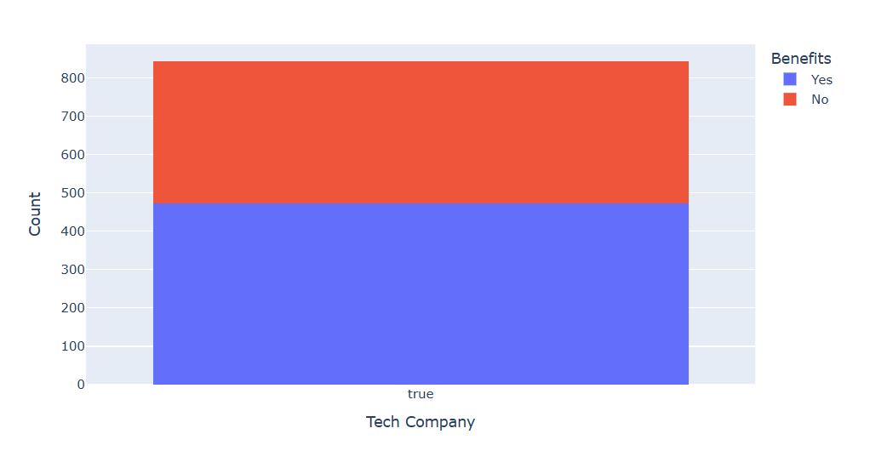
Do tech-company employees receive mental-health benefits?
Tech-company employees show a high level of access to mental-health benefits..

Slide 16
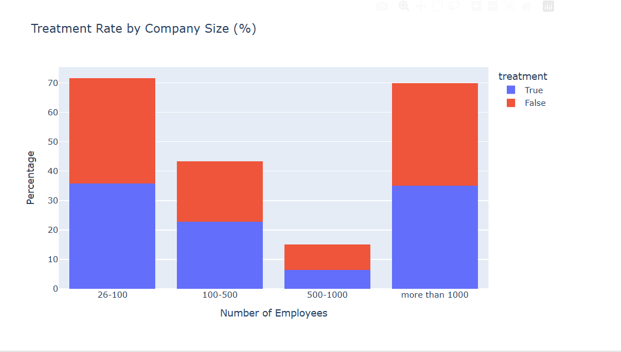
What percentage of employees within each company size have sought mental-health treatment?
Treatment-seeking is most common in smaller companies (26–100 employees). Rates drop significantly in mid-large firms (500–1000), then rise again slightly in very large organizations (1000+ employees).

Slide 17
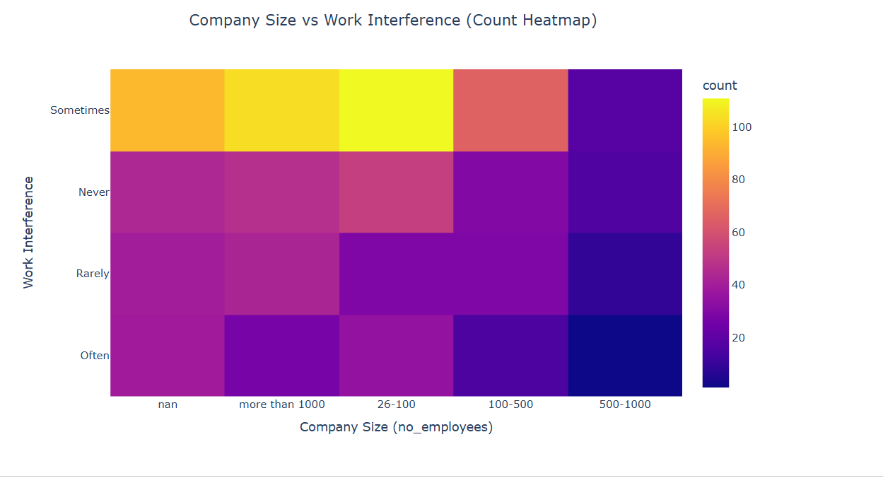
How does company size relate to the frequency of work interference caused by mental-health issues?
The heatmap shows that “Sometimes” is the most frequently reported level of work interference across all company sizes. Mental-health interference appears common in companies of all sizes, with no strong pattern indicating that larger companies experience more interference than smaller ones.
.

Slide 18
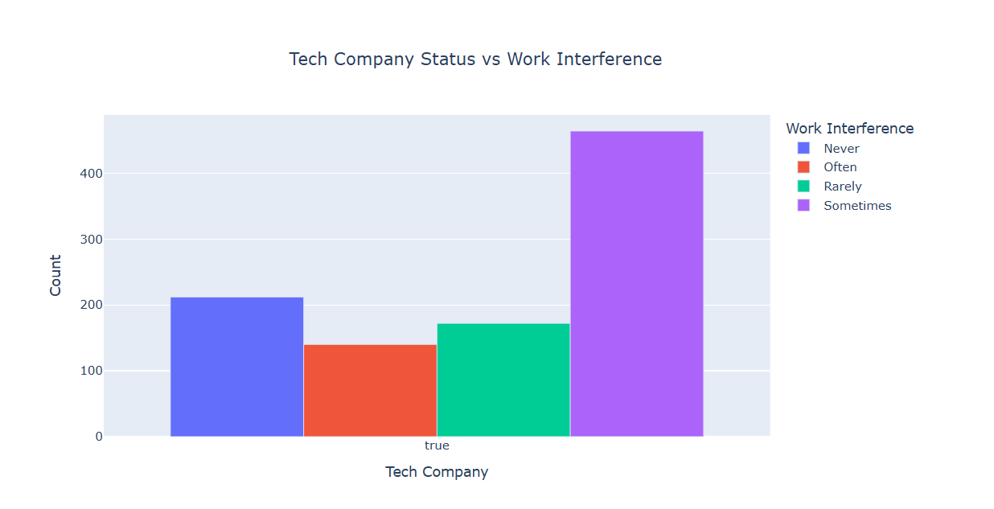
Do tech-company employees experience work interference from mental-health issues?
Among tech-company employees, “Sometimes” is the most frequently reported level of work interference.
.

Slide 19

Mental-Health Outcomes & Treatment Patterns

Slide 20
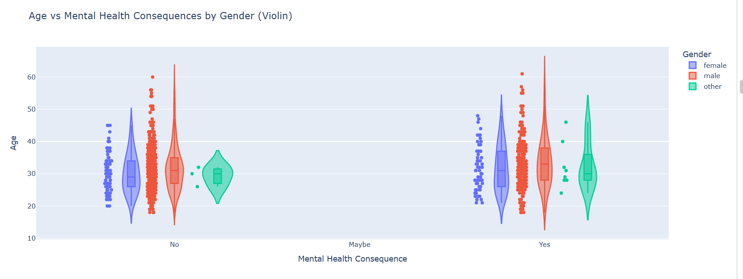
How does age relate to mental-health consequences, and does gender affect this relationship?
Respondents aged 25–40 are the most likely to report mental-health consequences, especially females

Slide 21
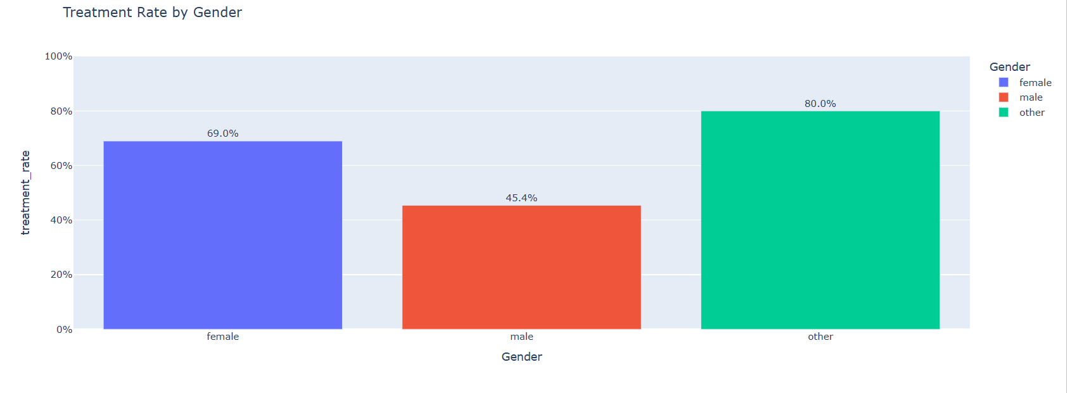
What proportion of people in each gender group have sought mental-health treatment?
Females (69%) and respondents in the ‘other’ gender group (80%) have higher treatment rates than males (45%). The ‘other’ group shows the highest likelihood of seeking treatment.

Slide 22
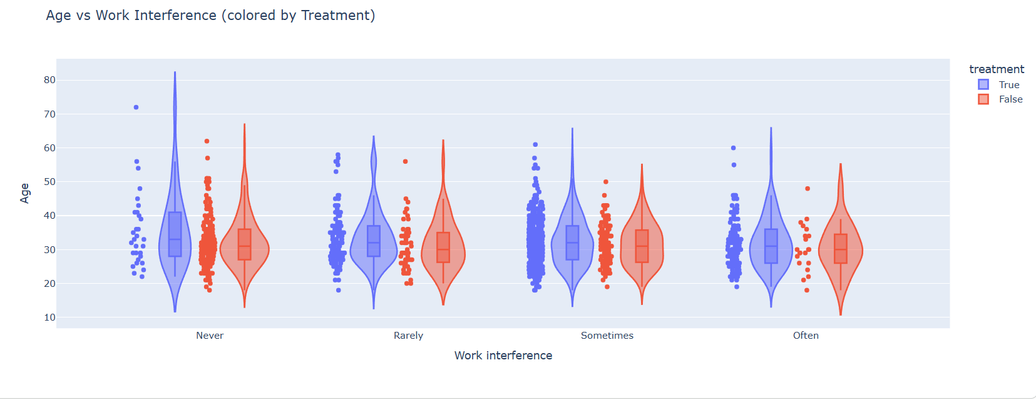
Does age influence how often mental-health issues interfere with work, and does treatment status change this pattern?
Younger employees and those already receiving treatment report higher levels of work interference from mental-health issues.

Slide 23
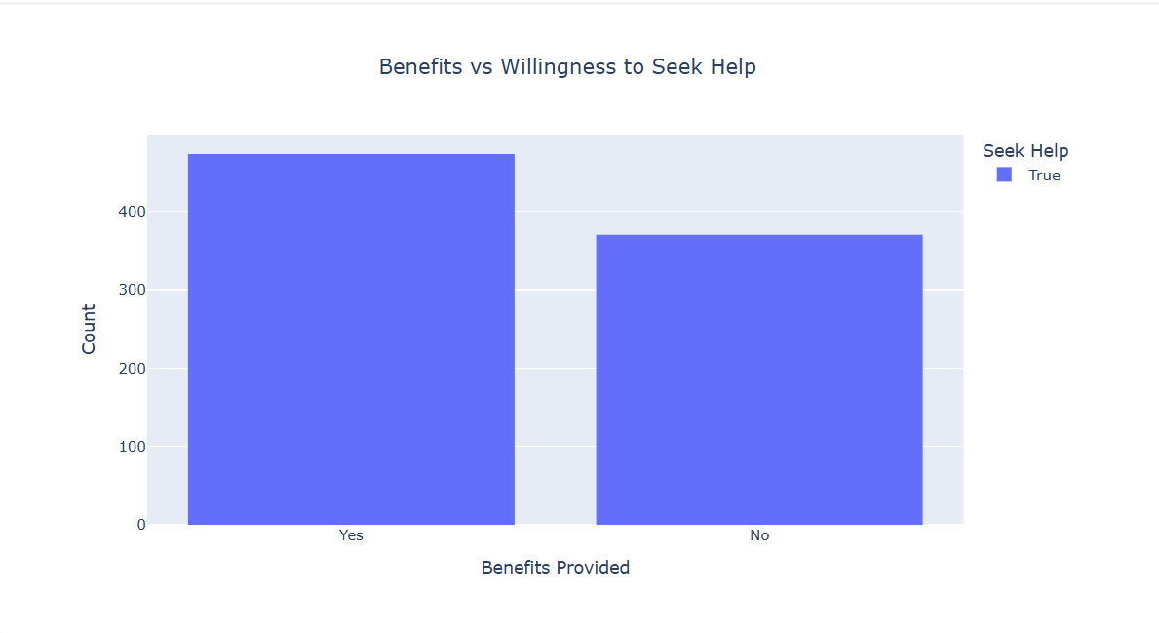
Does offering mental-health benefits increase employees’ willingness to seek professional help?
Employees with mental-health benefits are far more willing to seek professional help than those without benefits.

Slide 24
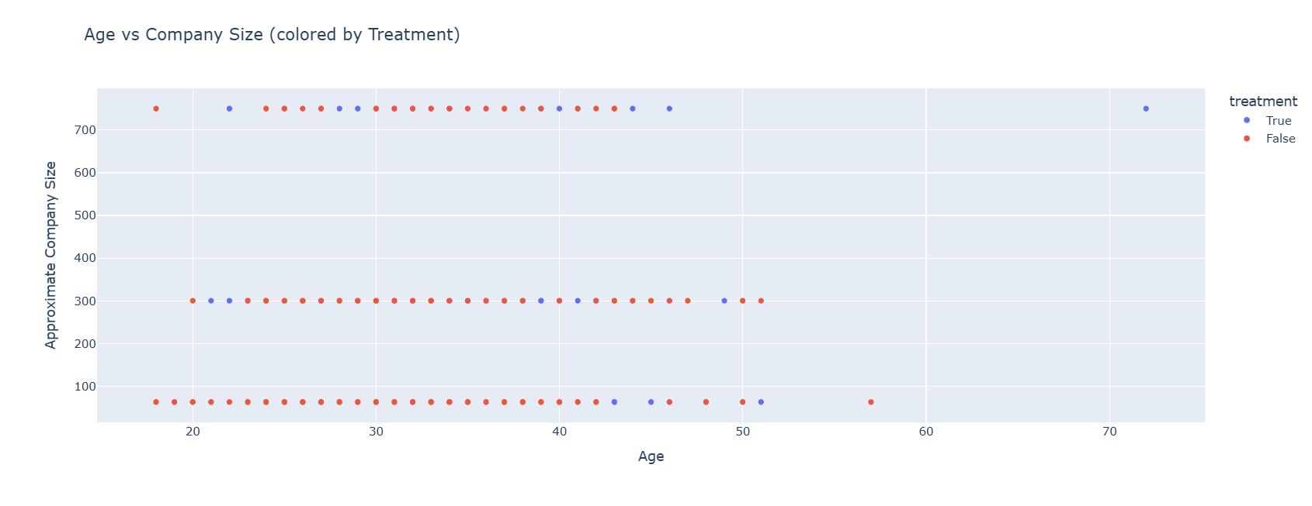
Is there a relationship between employee age, company size, and the likelihood of seeking mental-health treatment?
There is no strong relationship between age or company size and seeking treatment, suggesting other factors drive the decision.

Slide 25

Geographical Insights

Slide 26
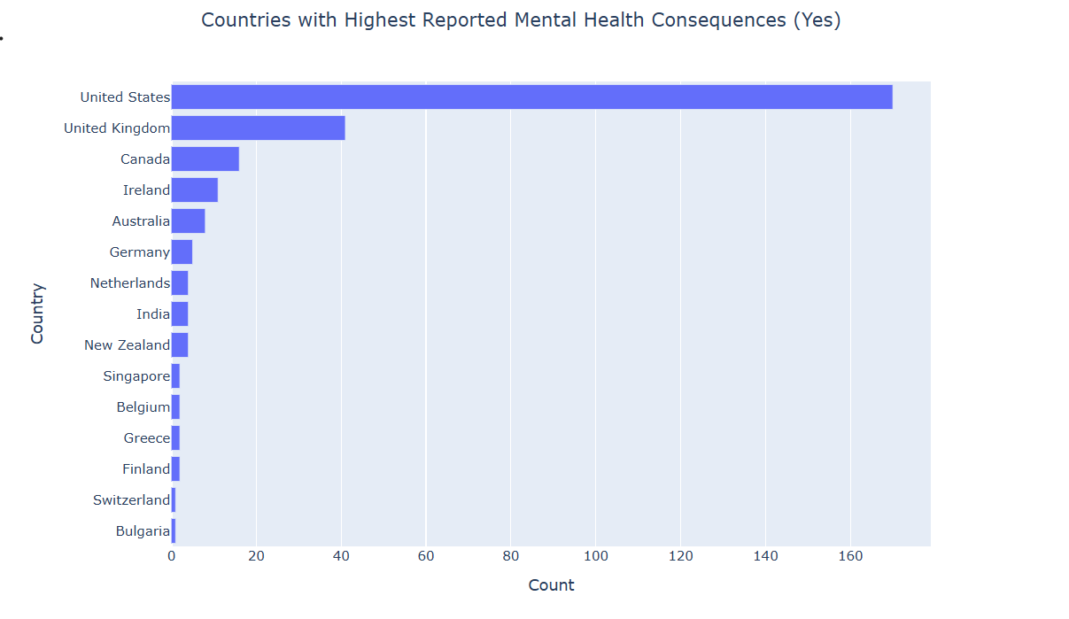
Which countries have the highest numbers of respondents reporting mental-health consequences?
The USA, UK, and Canada have the highest numbers of respondents reporting mental-health consequences..

Slide 27
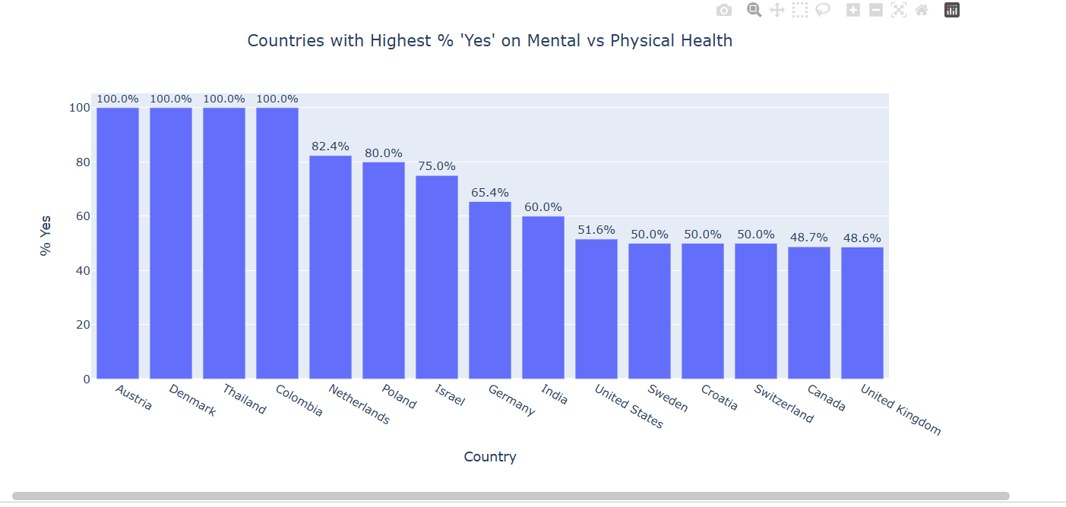
In which countries do respondents most strongly agree that mental health is as important as physical health?.
Austria, Denmark, Thailand, and Colombia all show 100% agreement.The USA is moderately at 51.6%, while the UK has one of the lowest levels at 48.6%.

Slide 28
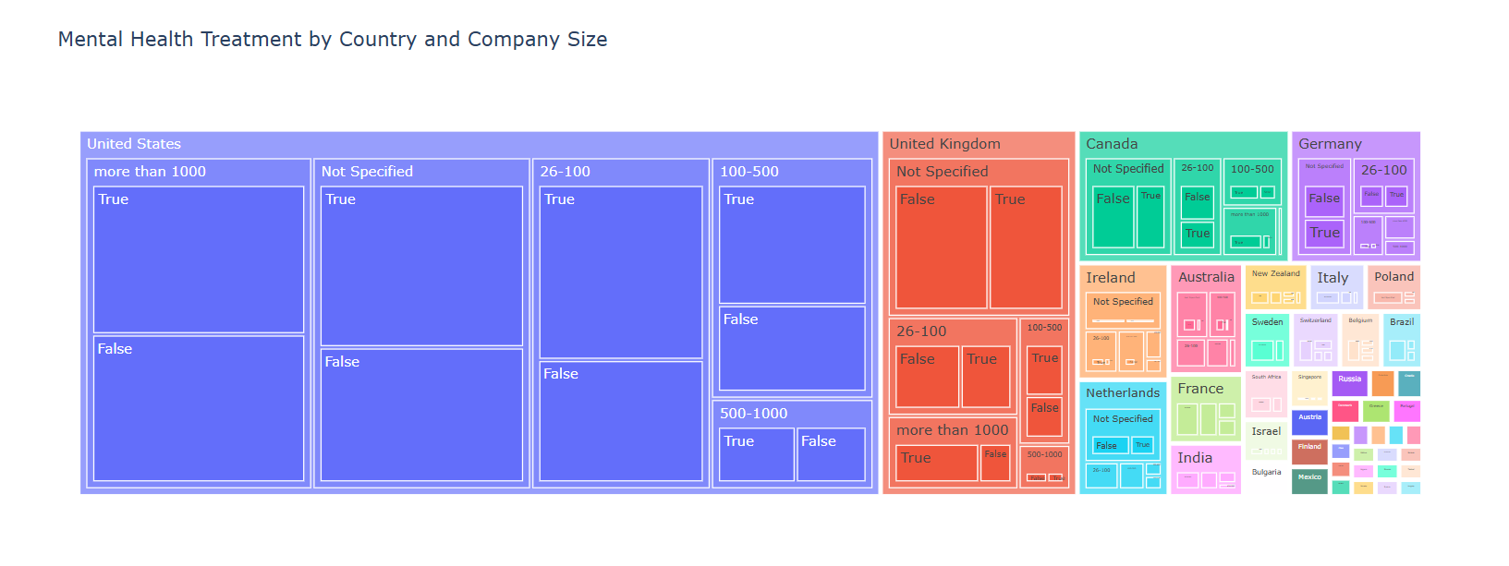
How does the distribution of mental-health treatment vary across countries and company sizes?
Treatment distribution varies across both countries and company sizes, with no uniform pattern

Slide 29

Thank you For Your Time

